Slide 1

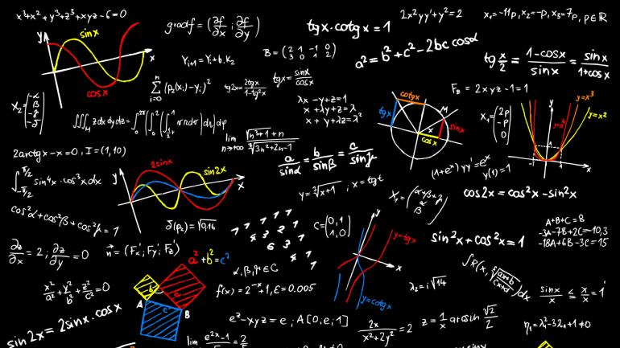
Pollard’s Rho Algorithm
TEAM MEMBERS:
Ashwin Anand
Mukesh SA
Dyanesh S
Madhav Harikumar
Arjun Santhosh
Adwaith S
Rajendra Prasad S
Sanjai Prasad
Siddharth Krishna

Slide 2

What is Pollard's Rho Algorithm?
It is an algorithm for integer factorization. It was invented by John Pollard in 1975.
Pollard’s algorithm relies upon several mathematical concepts. This algorithm is used in Cryptography.
Pollard’s algorithm had its most notable success in factoring the eighth Fermat number. The Fermat numbers are the sequence F_n = 2^[2^n] + 1, with n nonnegative.
Pollard’s Algorithm provides a simple and easy-to-follow method for finding a given number’s prime factors, and it is much more satisfying and less time consuming in this objective than other methods such as brute force.

Slide 3

Algorithm
Start with random x and c. Take y equal to x and f(x) = x² + c.
While a divisor isn’t obtained
Update x to f(x) (modulo n) [Tortoise Move]
Update y to f(f(y)) (modulo n) [Hare Move]
Calculate GCD of |x-y| and n
If GCD is not unity
If GCD is n, repeat from step 2 with another set of x, y and c
Else GCD is our answer

Slide 4

Underlying concepts
Pollard’s rho algorithm uses multiple probability and group theory concepts to create a fairly efficient method of calculating the factor of a given number.
The core concepts are:
Modulo operation
Pseudo randomness
Birthday paradox
Cycle detection and Floyd cycles
GCD properties
While not all are necessary for the functioning of the algorithm, they make the algorithm more efficient.

Slide 5

Modulo Operation
The modulo operation is used to the remainder after dividing two numbers. For each n there are a fixed number of possible modulos, i.e. the set of numbers from 0 to n-1 ({0,1,...,n-1)}.
The reason the modulo operation is extremely useful, is that it is capable of converting any number of any magnitude, to a number below itself. This means that any computation can be done within a much smaller range.
In the Pollard’s rho algorithm, we use the operation to keep the range small, as all factors of n will occur within n anyway.

Slide 6

Pseudo randomness
As the name suggests, “pseudo”randomness is something that seems random, but is completely deterministic and can be recreated. It is as close as one can get to completely random numbers, while still being able to generate and use data as per need.
In the Pollard’s rho algorithm, a pseudorandom number generator is used to generate the constant and the initial values. This is done repetitively to cover all the possibilities in the solution. Also, the function f(x) = x² + a acts like a pseudorandom number generator.
The only issue that occurs when using such a function, is the possibility of a cycle being formed, resulting in an infinite loop which will never give the answer. This issue is handled by cycle detection algorithms.

Slide 7

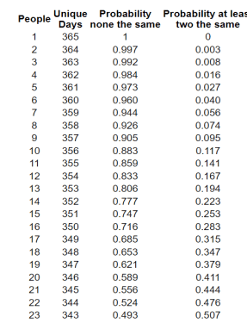
The Birthday paradox
The birthday paradox is a veridical paradox, which states that the probability of at least two people sharing a birthday in a room of just 23, is over 50%. It seems counterintuitive and wrong, but the math is in fact correct.
The reason behind the correctness is the idea of a logical complement. The statement “at least 2 people share a birthday” has the complement “no two people share a birthday”. This would imply that all the birthdays are different, which changes the approach to the question.

Slide 8

Application of the problem
Using the naive trial by division, we see that it will take (n-3) iterations to find the factors. The birthday paradox gives us a property, which can be used to reduce this time by more than half.
Rather than trying to find a factor directly, we could try to search for numbers whose difference is the required number. The reason for this is because it will be the direct application of the paradox.
There is a much higher probability of two numbers having the difference that is a factor of n, rather than finding a factor of n itself.
By changing the question to resemble the birthday paradox, we can use the fact that just checking over sqrt(n) will give us a < 50% chance of getting an answer.

Slide 9

Cycle Detection
Cycle detection is an important problem in computer science. When a function maps a set s to itself, there will be a repetition in the second value, meaning that for a distinct i and j, there exists a value k such that f(i) = f(j) = k.
When this happens, it causes a repetition in the sequence, causing a certain set of elements to cycle again.
One of the most well known and commonly used cycle detection algorithms is Floyd’s cycles, also known as the hare-tortoise algorithm.

Slide 10

Hare and Tortoise
The hare and tortoise algorithm uses a very simple idea:
Initialize two runners. One moves at twice the speed of the other. It is guaranteed that at some point, both runners will be at the same value. The difference will be the period of the loop.
The reason this happens to be useful in the case of Pollard’s rho method, is due to the presence of cycles that do not generate the required value. If x_{i} = f(x_{i-1}) & y_{i} = (y_{i-1}), there is a possibility that the case x = y occurs before the GCD(|x-y|,n) !=1 or n.
Using the hare and tortoise algorithm along with the birthday paradox implementation, we will be able to obtain the answer in a far more efficient way when compared to trial division.

Slide 11

Code implementation (in python)
import math
import random
from prettytable import PrettyTable
def display(h_list,t_list,gcd):
Table = PrettyTable(["Tortoise Move","Hare Move","GCD((Hare-Tortoise),n)"])
for i in range(len(h_list)):
Table.add_row([h_list[i],t_list[i],gcd[i]])
print(Table)
def pseudo_random_generator(x,n):
return (x**2+1)%n

Slide 12
Cont…
def pollard_rho(n):
_gcd = 1
tortoise = random.randint(1,n)
hare = tortoise
print("Random number chosen: "+str(hare))
t_list,h_list,gcd = [],[],[]
while _gcd == 1:
tortoise = pseudo_random_generator(tortoise,n)
hare = pseudo_random_generator(pseudo_random_generator(hare,n),n)
t_list.append(tortoise)
h_list.append(hare)
_gcd = math.gcd(abs(hare-tortoise),n)
gcd.append(_gcd)

Slide 13
Cont…
if _gcd == n:
print("Algorithm failed. Try again with different parameter")
return 0
else:
display(h_list,t_list,gcd)
return _gcd
n = int(input("Enter a number: "))
result = pollard_rho(n)
if result != 0:
print("One of the divisors: "+str(result))

Slide 14

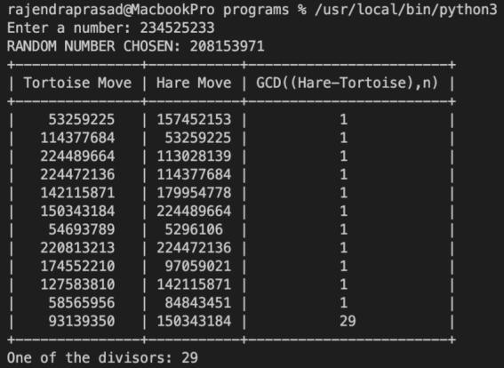
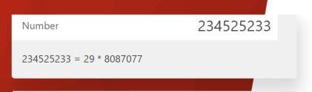
Output and Verification

Slide 15

THANK YOU!
TEAM MEMBERS:
Ashwin Anand : CB.EN.U4CYS21012
Mukesh SA : CB.EN.U4CYS21046
Rajendraprasad S : CB.EN.U4CYS21064
Madhav Harikumar : CB.EN.U4CYS21038
Dyanesh S : CB.EN.U4CYS21015
Arjun Santhosh : CB.EN.U4CYS21010
Siddharth Krishna : CB.EN.U4CYS21058
Adwaith S : CB.EN.U4CYS21063
Sanjai Prasad : CB.EN.U4CYS21066

